Slide 1



Cybersecurity Legislation and Regulation
Notes:
12. **Cybersecurity Leglisation and Regulation (30 mins)**
- Based on all the information we have covered so far, we should discuss legislation and regulations (including those in Saudi Arabia, the United Kingdom, the United States, and the EU).
- Topics:
- Legislation and Regulation
- Saudi Arabia
- United Kingdom
- United States
- European Union

Slide 2
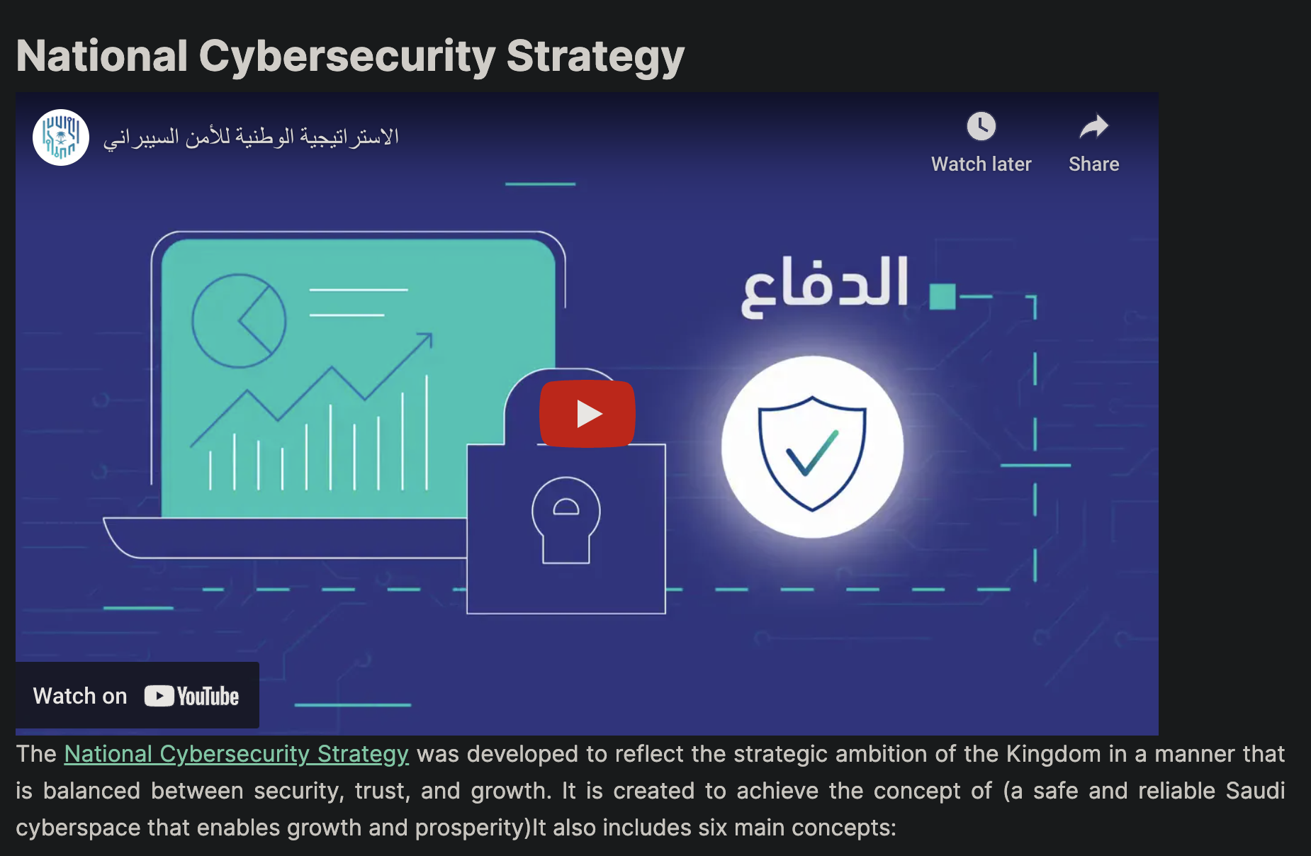
https://www.youtube.com/watch?v=pbpNubdevvM

Slide 3
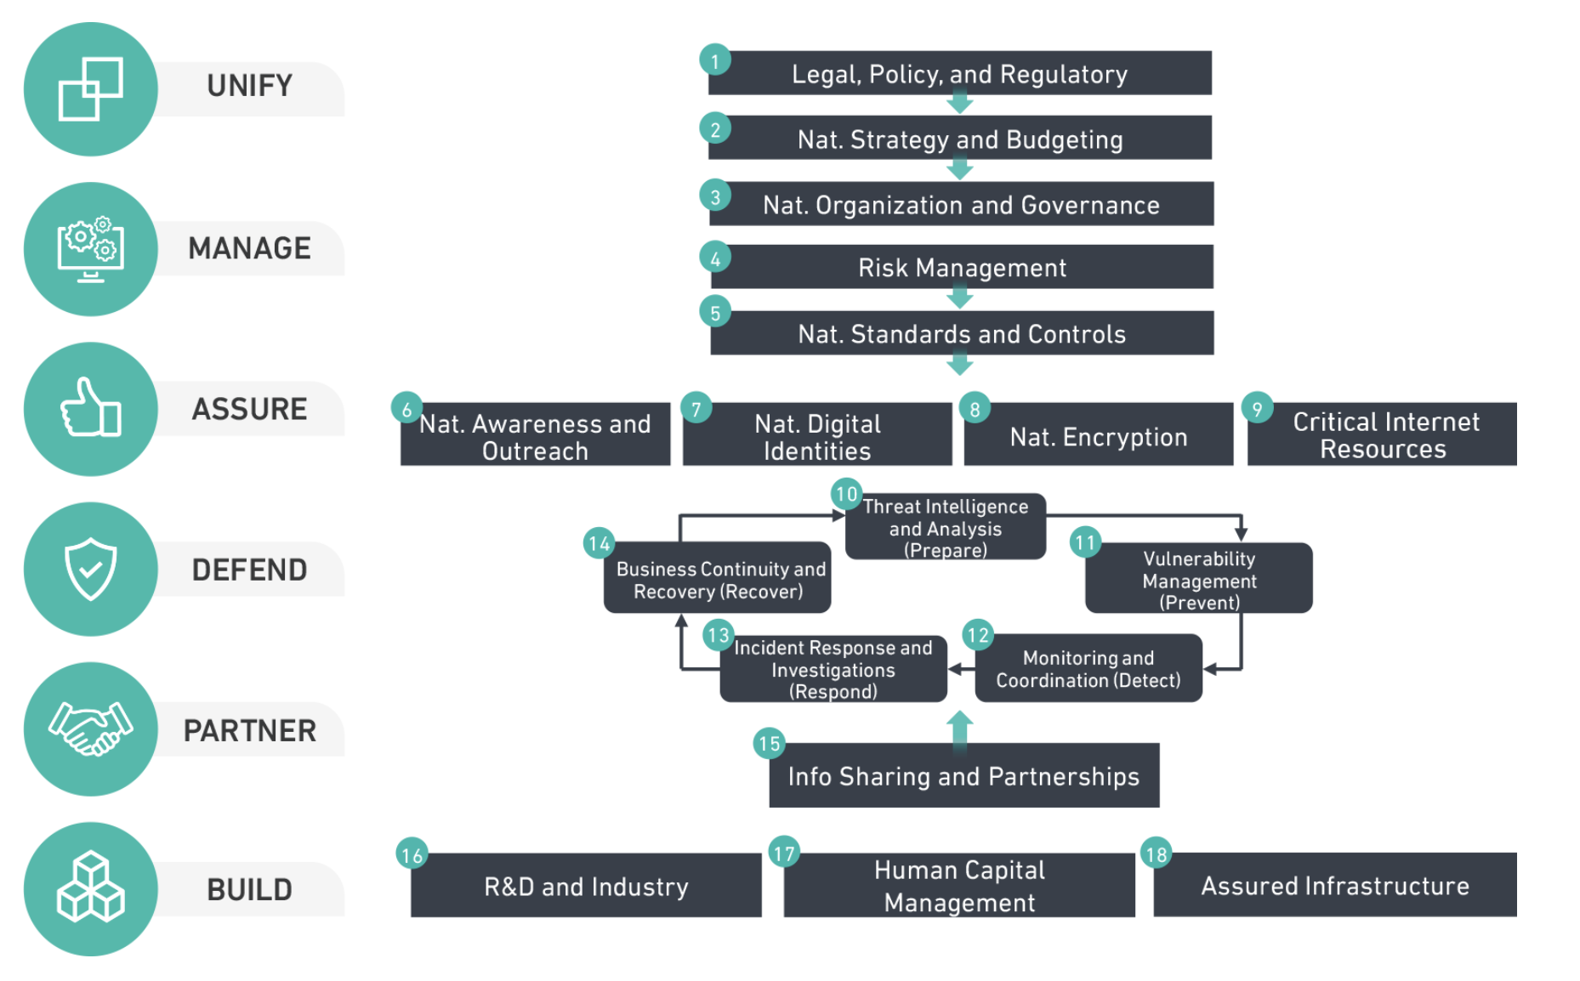
https://www.nca.gov.sa/en/strategic

Slide 4
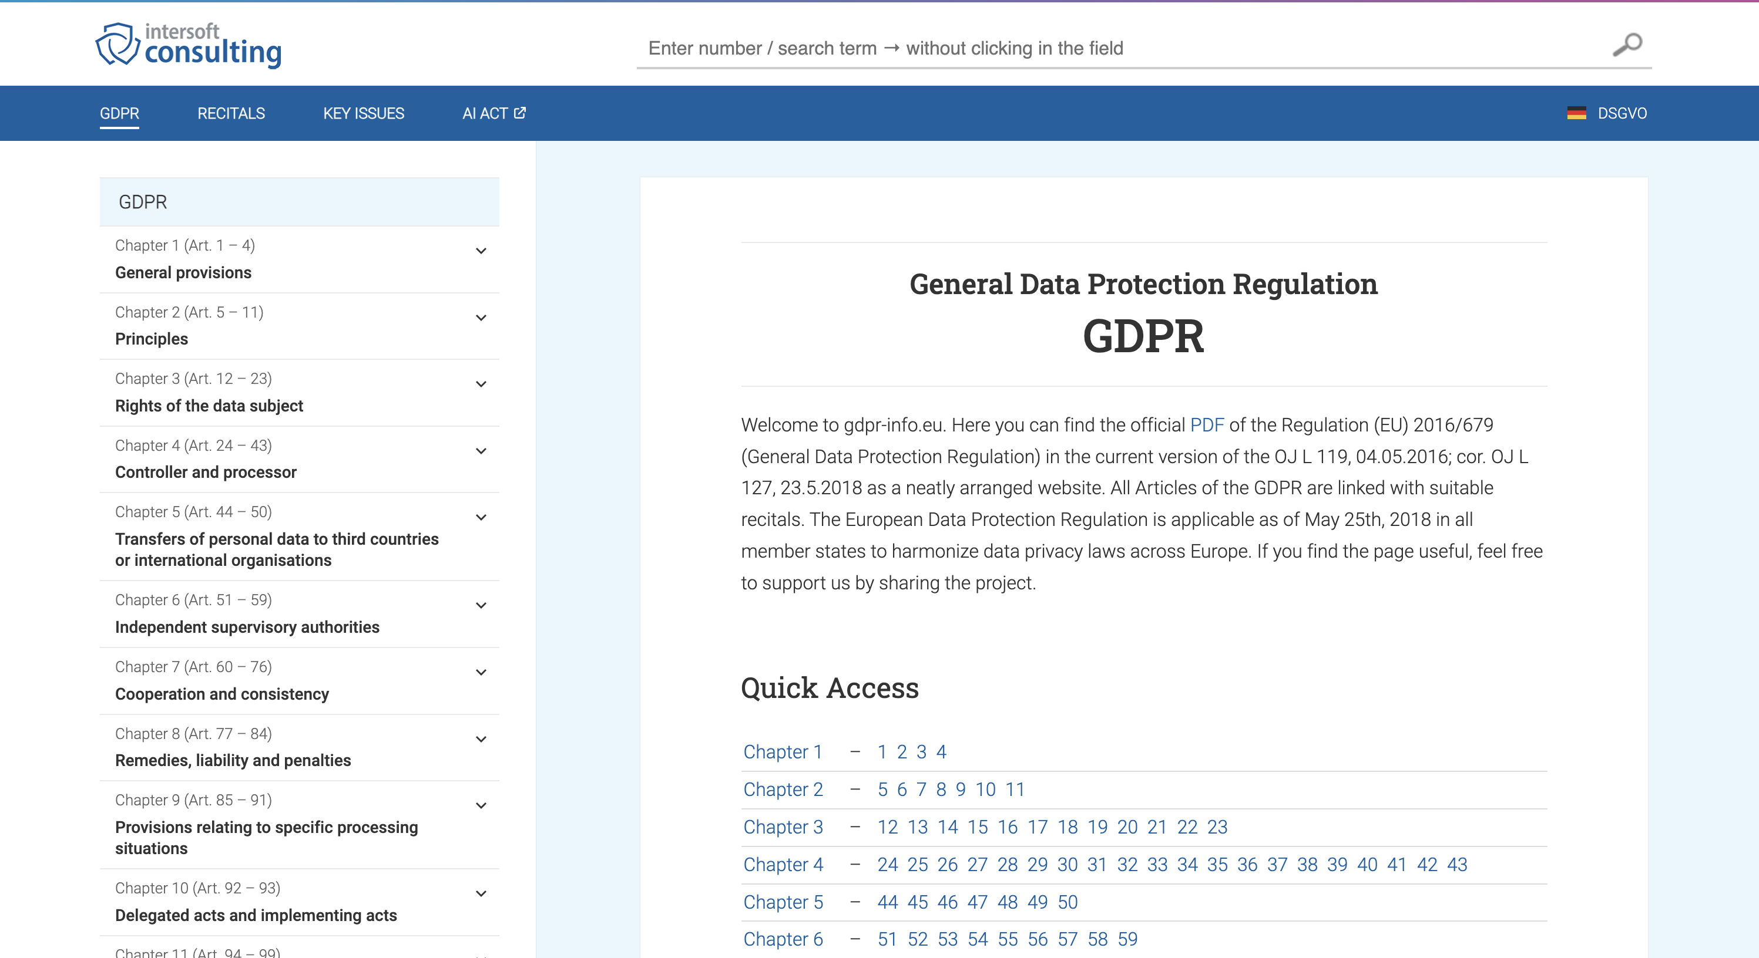
https://gdpr-info.eu/

Slide 5
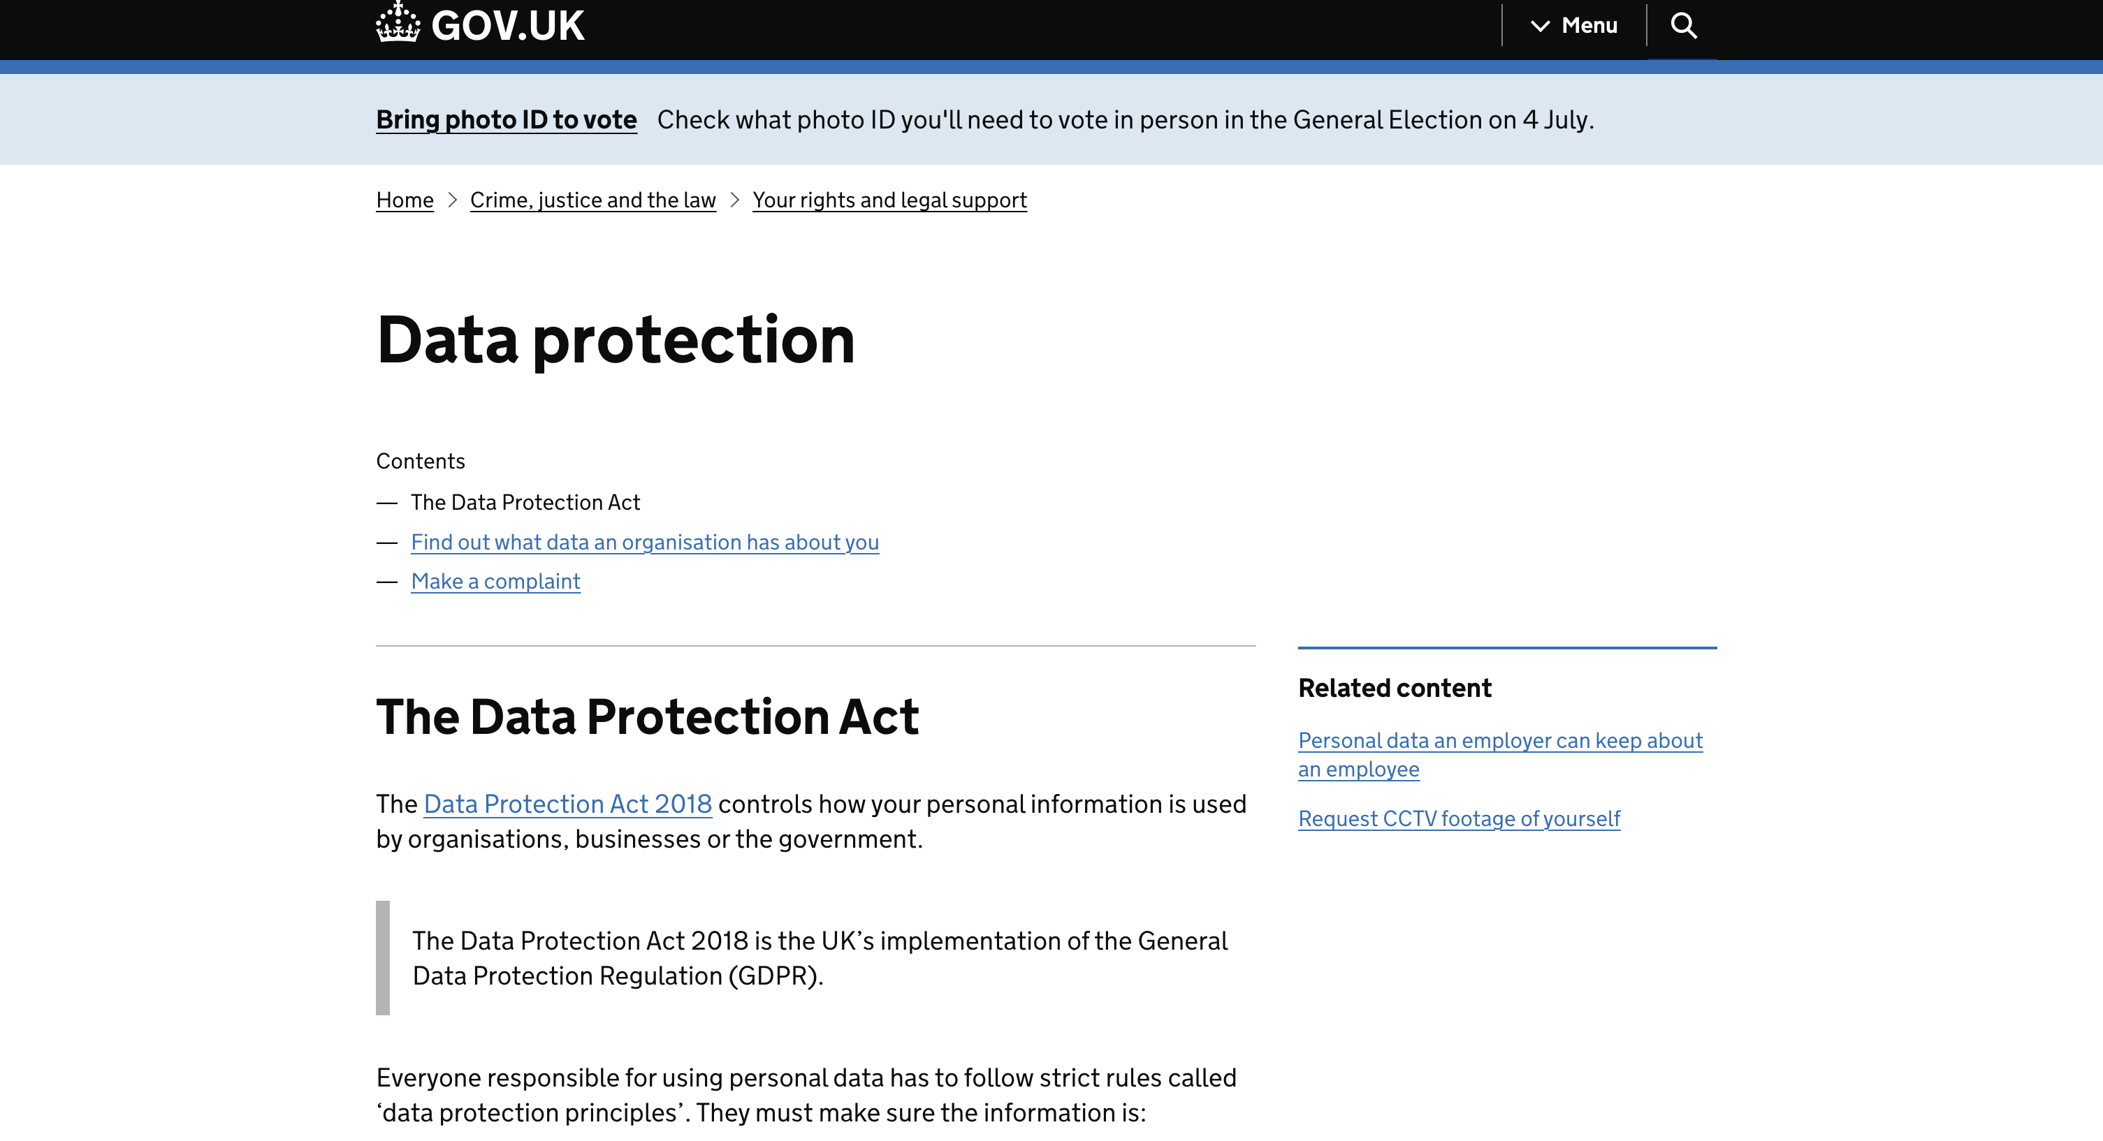
https://www.gov.uk/data-protection

Slide 6
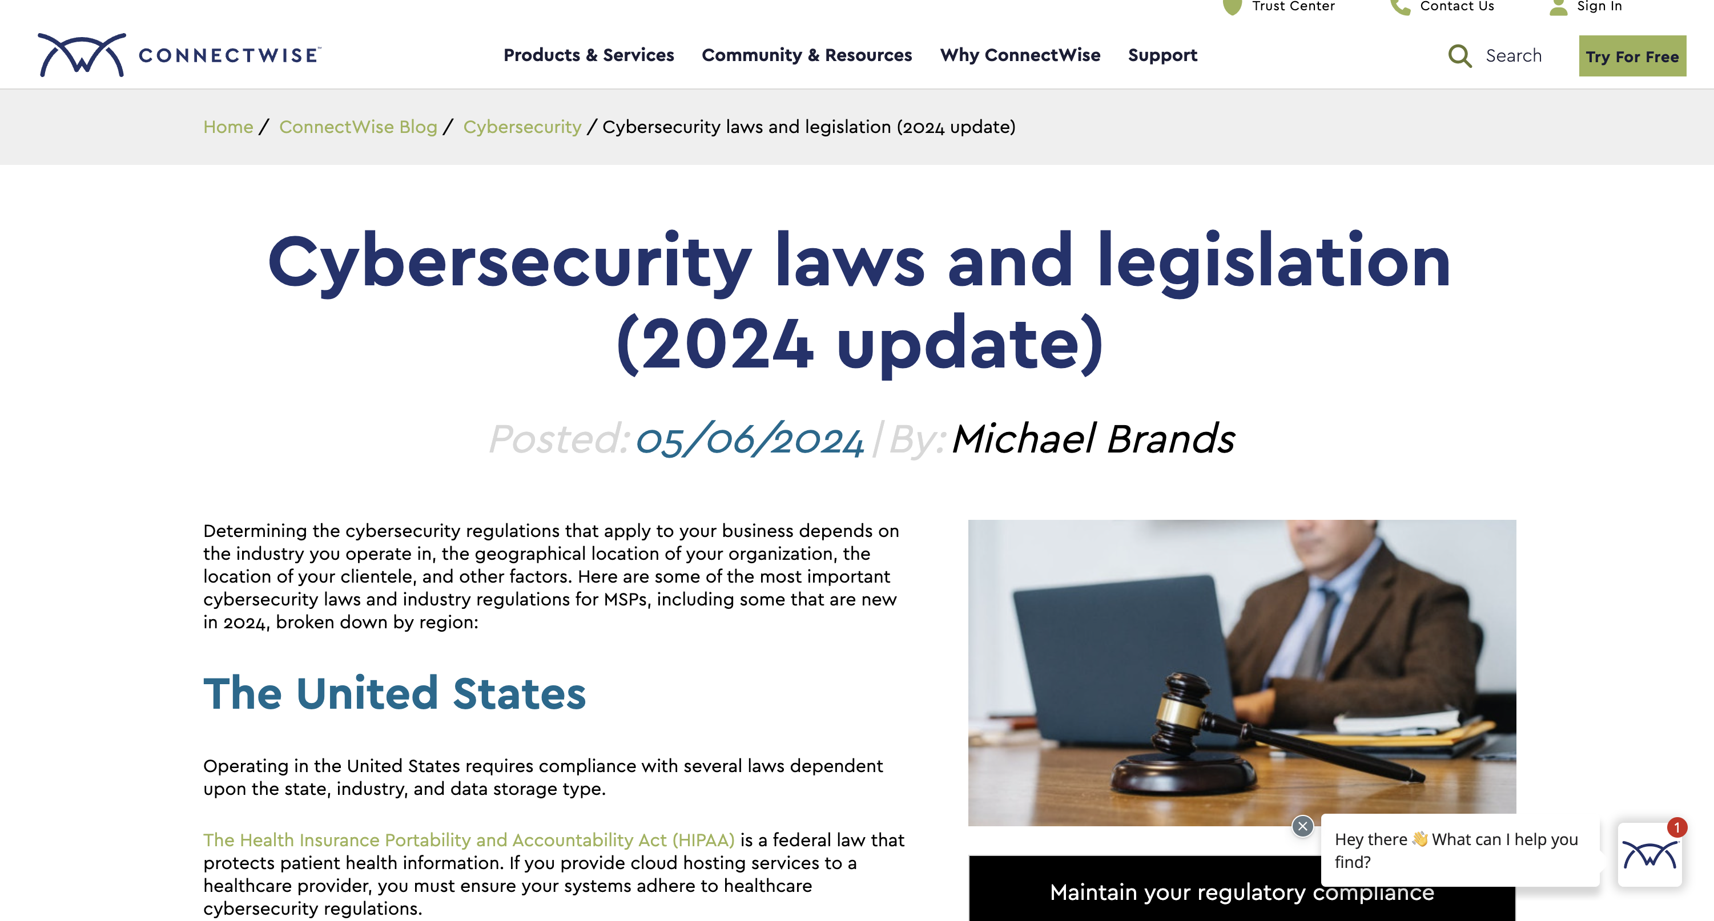
https://www.connectwise.com/blog/cybersecurity/cybersecurity-laws-and-legislation

